Slide 1

The Force is Strong with Kotlin
Presenter: Christoff Smith
Date: 27/06/2023

Slide 2
About me
Java Developer and Scrum Master @ Team Wonen Aankoop
17 years of Java experience
Primarily in the Banking sector
Standard Bank
ABSA
FNB
ING

Slide 3

A brief …
Browser &
Natively on devices
Runs everywhere
Statically typed
Type checking at compile time
Developed by JetBrains
Overview
Portable to any operating system
Enterprise ready since 2015
100% interoperable with Java
Mix Java & Kotlin libraries
Notes:
Statically typed programming language for the JVM, Android and the browser (type checking at compile-time)
Portable to any operating system
100% interoperable with Java
Runs on a browser
Runs Natively on devices
Kotlin/Native is primarily designed to allow compilation for platforms where virtual machines are not desirable or possible (such as iOS, embedded targets), or where developer is willing to produce reasonably-sized self-contained program without need to ship an additional execution runtime.

Slide 4

Why Kotlin (1)
Notes:
Concise -Kotlin is more concise than Java – drastically reduce amount of boilerplate code

Slide 5

Why Kotlin (2)
Notes:
Safe - You can choose to avoid entire classes of errors such as null pointer exceptions

Slide 6

Why Kotlin (3)
Notes:
Versatile - Build server-side applications, Android apps or frontend code running in the browser

Slide 7

Why Kotlin (4)
Notes:
Interoperable - Leverage existing libraries for the JVM, Android and the browser.

Slide 8

Why Kotlin (5)
Notes:
Tool-friendly - Choose any Java IDE or build from the command line.

Slide 9

Some …

Slide 10
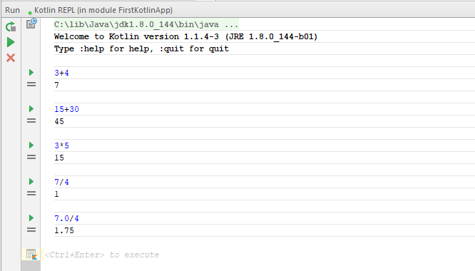
REPL (Read Eval Print Loop)
Enter a statement and press Ctrl + Enter to evaluate the expression.

Slide 11
REPL (Read Eval Print Loop)
Enter a statement and press Ctrl + Enter to evaluate the expression.

Slide 12
REPL (Read Eval Print Loop)
Enter a statement and press Ctrl + Enter to evaluate the expression.

Slide 13
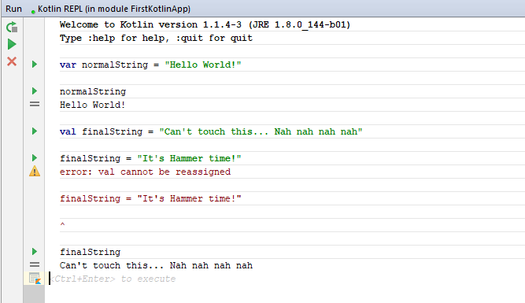
REPL – vars and vals
Notes:
Good practise to use val for finals.
Notes:
Vals similar to let in C# and const in JavaScript

Slide 14
REPL – vars and vals
Notes:
Good practise to use val for finals.
Notes:
Vals similar to let in C# and const in JavaScript

Slide 15
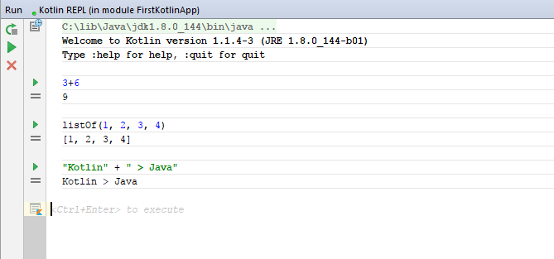
REPL – Expressions vs. Statements
Expressions:
Notes:
Talk about the return types

Slide 16
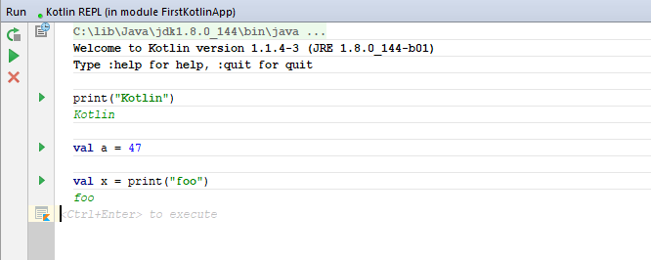
REPL – Expressions vs. Statements
Statements:
Notes:
A function call that does not have a return value is a statement
A statement is just a piece of code that does not have a value
Special: A statement won’t print anything unless it is a print function
val a = 47 [right side is an expression]
val x = print(“foo”) [right side will be evaluated and print foo]

Slide 17
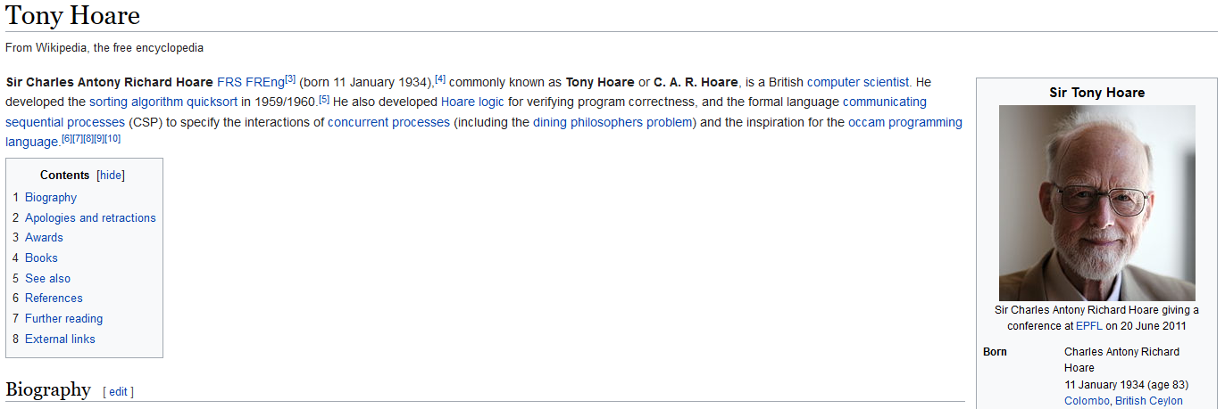
REPL – Nullable variables (1)
NULLS ARE BAD! NULLS ARE DANGEROUS!
Notes:
British Computer Scientist who developed the quicksort algorithm and the null reference amongst other things.

Slide 18
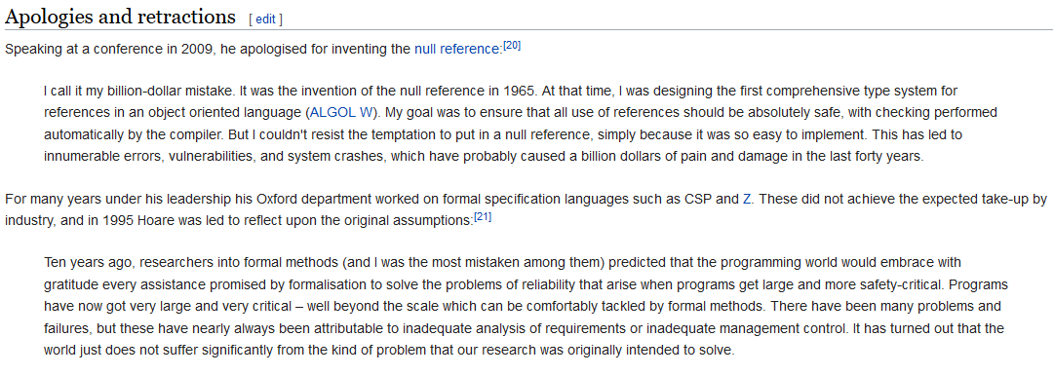
REPL – Nullable variables (2)
Inventor apologises…, for a “billion dollar mistake”!
Notes:
He wanted the use of references to be absolutely safe, and the temptation to create a null reference was just too big as it was east to do.
This led to innumerable errors, vulnerabilities and system crashes…

Slide 19
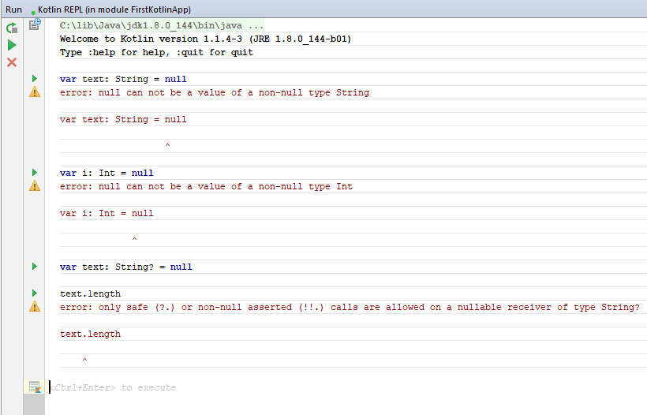
REPL – Nullable variables (3)
Notes:
You will get compilation errors here.

Slide 20
REPL – Nullable variables (4)
Notes:
You will get compilation errors here.

Slide 21
REPL – Nullable variables (5)
Notes:
You will get compilation errors here.

Slide 22
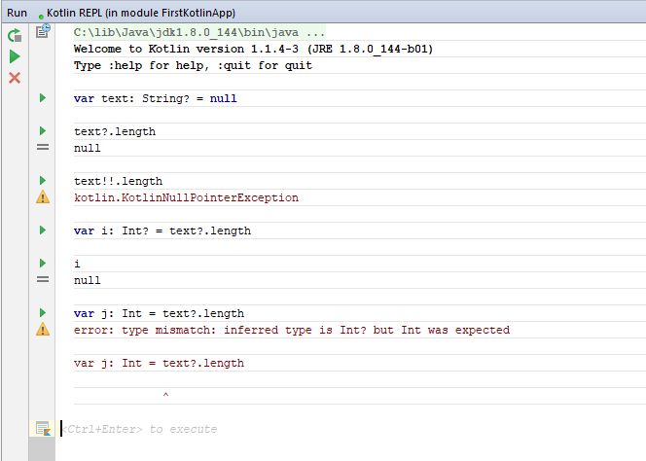
REPL – Nullable variables (6)
Notes:
Use ? to say you want to work with nulls

Slide 23
REPL – Nullable variables (7)
Notes:
Use ? to say you want to work with nulls

Slide 24
REPL – Nullable variables (8)
Notes:
Use ? to say you want to work with nulls

Slide 25

Best features of …

Slide 26

Code Conciseness

Slide 27
Code Conciseness (1)
package examples fun main(args: Array<String>) { val mode: Int = 11 val result = when (mode) { 1 -> "The mode is lazy" 2 -> { "So the mode is busy." } in 3..10 -> "Now this is looking interesting, between 3 and 10" !in 11..14 -> "Not in 11 to 14" 3 * 5 -> "The mode is super-productive, being 3*5" 11 -> "I don't know that mode. The mode is $mode" else -> "I don't know that mode. The mode is $mode" } println("Result = " + result) }

Slide 28
Code Conciseness (2)
package examples fun main(args: Array<String>) { val mode: Int = 11 val result = when (mode) { 1 -> "The mode is lazy" 2 -> { "So the mode is busy." } in 3..10 -> "Now this is looking interesting, between 3 and 10" !in 11..14 -> "Not in 11 to 14" 3 * 5 -> "The mode is super-productive, being 3*5" 11 -> "I don't know that mode. The mode is $mode" else -> "I don't know that mode. The mode is $mode" } println("Result = " + result) }

Slide 29
Code Conciseness (3)
package examples fun main(args: Array<String>) { val mode: Int = 11 val result = when (mode) { 1 -> "The mode is lazy" 2 -> { "So the mode is busy." } in 3..10 -> "Now this is looking interesting, between 3 and 10" !in 11..14 -> "Not in 11 to 14" 3 * 5 -> "The mode is super-productive, being 3*5" 11 -> "I don't know that mode. The mode is $mode" else -> "I don't know that mode. The mode is $mode" } println("Result = " + result) }

Slide 30
Code Conciseness (4)
package examples fun main(args: Array<String>) { val mode: Int = 11 val result = when (mode) { 1 -> "The mode is lazy" 2 -> { "So the mode is busy." } in 3..10 -> "Now this is looking interesting, between 3 and 10" !in 11..14 -> "Not in 11 to 14" 3 * 5 -> "The mode is super-productive, being 3*5" 11 -> "I don't know that mode. The mode is $mode" else -> "I don't know that mode. The mode is $mode" } println("Result = " + result) }

Slide 31
Code Conciseness (5)
package examples fun main(args: Array<String>) { val mode: Int = 11 val result = when (mode) { 1 -> "The mode is lazy" 2 -> { "So the mode is busy." } in 3..10 -> "Now this is looking interesting, between 3 and 10" !in 11..14 -> "Not in 11 to 14" 3 * 5 -> "The mode is super-productive, being 3*5" 11 -> "I don't know that mode. The mode is $mode" else -> "I don't know that mode. The mode is $mode" } println("Result = " + result) }

Slide 32
Code Conciseness (6)
package examples fun main(args: Array<String>) { val mode: Int = 11 val result = when (mode) { 1 -> "The mode is lazy" 2 -> { "So the mode is busy." } in 3..10 -> "Now this is looking interesting, between 3 and 10" !in 11..14 -> "Not in 11 to 14" 3 * 5 -> "The mode is super-productive, being 3*5" 11 -> "I don't know that mode. The mode is $mode" else -> "I don't know that mode. The mode is $mode" } println("Result = " + result) }

Slide 33
Code Conciseness (7)
package examples fun main(args: Array<String>) { val mode: Int = 11 val result = when (mode) { 1 -> "The mode is lazy" 2 -> { "So the mode is busy." } in 3..10 -> "Now this is looking interesting, between 3 and 10" !in 11..14 -> "Not in 11 to 14" 3 * 5 -> "The mode is super-productive, being 3*5" 11 -> "I don't know that mode. The mode is $mode" else -> "I don't know that mode. The mode is $mode" } println("Result = " + result) }

Slide 34
Code Conciseness (8)
package examples fun main(args: Array<String>) { val mode: Int = 11 val result = when (mode) { 1 -> "The mode is lazy" 2 -> { "So the mode is busy." } in 3..10 -> "Now this is looking interesting, between 3 and 10" !in 11..14 -> "Not in 11 to 14" 3 * 5 -> "The mode is super-productive, being 3*5" 11 -> "I don't know that mode. The mode is $mode" else -> "I don't know that mode. The mode is $mode" } println("Result = " + result) }

Slide 35
Code Conciseness (9)
package examples fun main(args: Array<String>) { val mode: Int = 11 val x = if (mode < 2) { println("Mode is less than 2") 17 } else { 42 "x marks the spot" } println("x = " + x) }

Slide 36
Code Conciseness (10)
package examples fun main(args: Array<String>) { val mode: Int = 11 val x = if (mode < 2) { println("Mode is less than 2") 17 } else { 42 "x marks the spot" } println("x = " + x) }

Slide 37

Null safety

Slide 38
Null safety (1)
JAVA:
List<String> nameList = null; if (nameList != null) { nameList.add("Theo"); } Optional<List<String>> nameList = Optional.ofNullable(null);
if (nameList.isPresent()) { nameList.get().add("Rory"); }

Slide 39
Null safety (2)
JAVA:
List<String> nameList = null; if (nameList != null) { nameList.add("Theo"); } Optional<List<String>> nameList = Optional.ofNullable(null);
if (nameList.isPresent()) { nameList.get().add("Rory"); }

Slide 40
Null safety (3)
KOTLIN:
var nameList: MutableList<String>? = null
nameList?.add("Corneil")
//throws Exception in thread "main" kotlin.KotlinNullPointerException
nameList!!.add(“Christoff")
Notes:
By default all the object are null safe so they will not accept null as a value but there are scenarios where the value could be null so for those cases explicitly you need to define them by adding ? after its type.

Slide 41
Null safety (4)
KOTLIN:
var nameList: MutableList<String>? = null
nameList?.add("Corneil")
//throws Exception in thread "main" kotlin.KotlinNullPointerException
nameList!!.add(“Christoff")
Notes:
By default all the object are null safe so they will not accept null as a value but there are scenarios where the value could be null so for those cases explicitly you need to define them by adding ? after its type.

Slide 42

Smart cast

Slide 43
Smart cast (1)
val n:Any = "Hello" when(n) { is String -> n.length is Int -> n.inc() }

Slide 44
Smart cast (2)
val n:Any = "Hello" when(n) { is String -> n.length is Int -> n.inc() }

Slide 45
Smart cast (3)
val n:Any = "Hello" when(n) { is String -> n.length is Int -> n.inc() }

Slide 46

Lazy Initialisation

Slide 47
Lazy Initialisation (1)
@Controller class GameController { companion object { internal val KALAHA_GAME = "kalahaGame" } @Resource(name = "gameService") internal val gameService: GameService? = null internal lateinit var kalahaGame: Kalaha @RequestMapping(value = "/startGame", method = arrayOf(RequestMethod.POST)) fun submit(@Valid @ModelAttribute("players") players: PlayerNames, result: BindingResult, model: ModelMap): String { kalahaGame = Kalaha(players) model.addAttribute(KALAHA_GAME, kalahaGame) return KALAHA_GAME } }

Slide 48
Lazy Initialisation (2)
@Controller class GameController { companion object { internal val KALAHA_GAME = "kalahaGame" } @Resource(name = "gameService") internal val gameService: GameService? = null internal lateinit var kalahaGame: Kalaha @RequestMapping(value = "/startGame", method = arrayOf(RequestMethod.POST)) fun submit(@Valid @ModelAttribute("players") players: PlayerNames, result: BindingResult, model: ModelMap): String { kalahaGame = Kalaha(players) model.addAttribute(KALAHA_GAME, kalahaGame) return KALAHA_GAME } }

Slide 49
Lazy Initialisation (3)
@Controller class GameController { companion object { internal val KALAHA_GAME = "kalahaGame" } @Resource(name = "gameService") internal val gameService: GameService? = null internal lateinit var kalahaGame: Kalaha @RequestMapping(value = "/startGame", method = arrayOf(RequestMethod.POST)) fun submit(@Valid @ModelAttribute("players") players: PlayerNames, result: BindingResult, model: ModelMap): String { kalahaGame = Kalaha(players) model.addAttribute(KALAHA_GAME, kalahaGame) return KALAHA_GAME } }

Slide 50
Lazy Initialisation (4)
@Controller class GameController { companion object { internal val KALAHA_GAME = "kalahaGame" } @Resource(name = "gameService") internal val gameService: GameService? = null internal lateinit var kalahaGame: Kalaha @RequestMapping(value = "/startGame", method = arrayOf(RequestMethod.POST)) fun submit(@Valid @ModelAttribute("players") players: PlayerNames, result: BindingResult, model: ModelMap): String { kalahaGame = Kalaha(players) model.addAttribute(KALAHA_GAME, kalahaGame) return KALAHA_GAME } }

Slide 51

Default & Named Arguments
Notes:
A data class is the same as a normal class, except for the fact that you can deconstruct the class into it’s base instance variables.

Slide 52
Default & Named Parameters (1)
//default value added class House(val height: Double, val colour: String, val price: Int = 50000) { fun print() { println("House [height=$height, colour=$colour, price=$price]") } } fun main(args: Array<String>) { val house = House(height = 4.5, colour = "Blue", price = 150000) //ordering of namedParamaters not important val redHouse = House(colour = "Red", price = 200000, height = 5.0) //no price needed as defaulted to 50000 val yellowHouse = House(colour = "Yellow", height = 2.5) house.print() redHouse.print() yellowHouse.print() }
Notes:
A data class is the same as a normal class, except for the fact that you can deconstruct the class into it’s base instance variables.

Slide 53
Default & Named Parameters (1)
//default value added class House(val height: Double, val colour: String, val price: Int = 50000) { fun print() { println("House [height=$height, colour=$colour, price=$price]") } } fun main(args: Array<String>) { val house = House(height = 4.5, colour = "Blue", price = 150000) //ordering of namedParamaters not important val redHouse = House(colour = "Red", price = 200000, height = 5.0) //no price needed as defaulted to 50000 val yellowHouse = House(colour = "Yellow", height = 2.5) house.print() redHouse.print() yellowHouse.print() }
Notes:
A data class is the same as a normal class, except for the fact that you can deconstruct the class into it’s base instance variables.

Slide 54
Default & Named Parameters (2)
//default value added class House(val height: Double, val colour: String, val price: Int = 50000) { fun print() { println("House [height=$height, colour=$colour, price=$price]") } } fun main(args: Array<String>) { val house = House(height = 4.5, colour = "Blue", price = 150000) //ordering of namedParamaters not important val redHouse = House(colour = "Red", price = 200000, height = 5.0) //no price needed as defaulted to 50000 val yellowHouse = House(colour = "Yellow", height = 2.5) house.print() redHouse.print() yellowHouse.print() }
Notes:
A data class is the same as a normal class, except for the fact that you can deconstruct the class into it’s base instance variables.

Slide 55
Default & Named Parameters (3)
//default value added class House(val height: Double, val colour: String, val price: Int = 50000) { fun print() { println("House [height=$height, colour=$colour, price=$price]") } } fun main(args: Array<String>) { val house = House(height = 4.5, colour = "Blue", price = 150000) //ordering of namedParamaters not important val redHouse = House(colour = "Red", price = 200000, height = 5.0) //no price needed as defaulted to 50000 val yellowHouse = House(colour = "Yellow", height = 2.5) house.print() redHouse.print() yellowHouse.print() }
Notes:
A data class is the same as a normal class, except for the fact that you can deconstruct the class into it’s base instance variables.

Slide 56
Default & Named Parameters (4)
//default value added class House(val height: Double, val colour: String, val price: Int = 50000) { fun print() { println("House [height=$height, colour=$colour, price=$price]") } } fun main(args: Array<String>) { val house = House(height = 4.5, colour = "Blue", price = 150000) //ordering of namedParamaters not important val redHouse = House(colour = "Red", price = 200000, height = 5.0) //no price needed as defaulted to 50000 val yellowHouse = House(colour = "Yellow", height = 2.5) house.print() redHouse.print() yellowHouse.print() }
Notes:
A data class is the same as a normal class, except for the fact that you can deconstruct the class into it’s base instance variables.

Slide 57

Data Classes & Optionals
Notes:
A data class is the same as a normal class, except for the fact that you can deconstruct the class into it’s base instance variables.

Slide 58
Data Classes & Optionals (1)
package examples data class Car(val colour: String, val weight: Double, val price: Double, val desc: String) fun main(args: Array<String>) { val toyota = Car(“Red", 1.5, 119999.99, "Toyota") val lexus = toyota.copy(price = 849999.99) val (_, toyotaWeight, toyotaPrice) = toyota println("toyota price = " + toyota.price) println("lexus price = " + lexus.price) println("optional toyota price = " + toyotaPrice) }
Notes:
A data class is the same as a normal class, except for the fact that you can deconstruct the class into it’s base instance variables.

Slide 59
Data Classes & Optionals (2)
package examples data class Car(val colour: String, val weight: Double, val price: Double, val desc: String) fun main(args: Array<String>) { val toyota = Car(“Red", 1.5, 119999.99, "Toyota") val lexus = toyota.copy(price = 849999.99) val (_, toyotaWeight, toyotaPrice) = toyota println("toyota price = " + toyota.price) println("lexus price = " + lexus.price) println("optional toyota price = " + toyotaPrice) }
Notes:
A data class is the same as a normal class, except for the fact that you can deconstruct the class into it’s base instance variables.

Slide 60
Data Classes & Optionals (3)
package examples data class Car(val colour: String, val weight: Double, val price: Double, val desc: String) fun main(args: Array<String>) { val toyota = Car(“Red", 1.5, 119999.99, "Toyota") val lexus = toyota.copy(price = 849999.99) val (_, toyotaWeight, toyotaPrice) = toyota println("toyota price = " + toyota.price) println("lexus price = " + lexus.price) println("optional toyota price = " + toyotaPrice) }
Notes:
A data class is the same as a normal class, except for the fact that you can deconstruct the class into it’s base instance variables.

Slide 61
Data Classes & Optionals (4)
package examples data class Car(val colour: String, val weight: Double, val price: Double, val desc: String) fun main(args: Array<String>) { val toyota = Car(“Red", 1.5, 119999.99, "Toyota") val lexus = toyota.copy(price = 849999.99) val (_, toyotaWeight, toyotaPrice) = toyota println("toyota price = " + toyota.price) println("lexus price = " + lexus.price) println("optional toyota price = " + toyotaPrice) }
*Deconstruction
Notes:
A data class is the same as a normal class, except for the fact that you can deconstruct the class into it’s base instance variables.

Slide 62
Data Classes & Optionals (5)
package examples data class Car(val colour: String, val weight: Double, val price: Double, val desc: String) fun main(args: Array<String>) { val toyota = Car(“Red", 1.5, 119999.99, "Toyota") val lexus = toyota.copy(price = 849999.99) val (_, toyotaWeight, toyotaPrice) = toyota println("toyota price = " + toyota.price) println("lexus price = " + lexus.price) println("optional toyota price = " + toyotaPrice) }
Notes:
A data class is the same as a normal class, except for the fact that you can deconstruct the class into it’s base instance variables.

Slide 63

Classes, Interfaces & Overriding
Notes:
A data class is the same as a normal class, except for the fact that you can deconstruct the class into it’s base instance variables.

Slide 64
Classes, Interfaces & Overriding
package examples interface Learnable { fun learn() { println("Learning...") } } abstract class ConferenceTopic(val topic: String, val minutes: Int) { open fun learn() { println("Learning about $topic.") } } class KotlinTopic() : ConferenceTopic("Kotlin", 45), Learnable { override final fun learn() { super<Learnable>.learn() super<ConferenceTopic>.learn() println("I'm one of the first people to learn Kotlin!") } } fun main(args: Array<String>) { val course = KotlinTopic() course.learn() }
Notes:
A data class is the same as a normal class, except for the fact that you can deconstruct the class into it’s base instance variables.

Slide 65
Classes, Interfaces & Overriding
package examples interface Learnable { fun learn() { println("Learning...") } } abstract class ConferenceTopic(val topic: String, val minutes: Int) { open fun learn() { println("Learning about $topic.") } } class KotlinTopic() : ConferenceTopic("Kotlin", 45), Learnable { override final fun learn() { super<Learnable>.learn() super<ConferenceTopic>.learn() println("I'm one of the first people to learn Kotlin!") } } fun main(args: Array<String>) { val course = KotlinTopic() course.learn() }
Notes:
A data class is the same as a normal class, except for the fact that you can deconstruct the class into it’s base instance variables.

Slide 66
Classes, Interfaces & Overriding
package examples interface Learnable { fun learn() { println("Learning...") } } abstract class ConferenceTopic(val topic: String, val minutes: Int) { open fun learn() { println("Learning about $topic.") } } class KotlinTopic() : ConferenceTopic("Kotlin", 45), Learnable { override final fun learn() { super<Learnable>.learn() super<ConferenceTopic>.learn() println("I'm one of the first people to learn Kotlin!") } } fun main(args: Array<String>) { val course = KotlinTopic() course.learn() }
Notes:
A data class is the same as a normal class, except for the fact that you can deconstruct the class into it’s base instance variables.

Slide 67
Classes, Interfaces & Overriding
package examples interface Learnable { fun learn() { println("Learning...") } } abstract class ConferenceTopic(val topic: String, val minutes: Int) { open fun learn() { println("Learning about $topic.") } } class KotlinTopic() : ConferenceTopic("Kotlin", 45), Learnable { override final fun learn() { super<Learnable>.learn() super<ConferenceTopic>.learn() println("I'm one of the first people to learn Kotlin!") } } fun main(args: Array<String>) { val course = KotlinTopic() course.learn() }
Notes:
A data class is the same as a normal class, except for the fact that you can deconstruct the class into it’s base instance variables.

Slide 68
Classes, Interfaces & Overriding
package examples interface Learnable { fun learn() { println("Learning...") } } abstract class ConferenceTopic(val topic: String, val minutes: Int) { open fun learn() { println("Learning about $topic.") } } class KotlinTopic() : ConferenceTopic("Kotlin", 45), Learnable { override final fun learn() { super<Learnable>.learn() super<ConferenceTopic>.learn() println("I'm one of the first people to learn Kotlin!") } } fun main(args: Array<String>) { val course = KotlinTopic() course.learn() }
Notes:
A data class is the same as a normal class, except for the fact that you can deconstruct the class into it’s base instance variables.

Slide 69

Extension Function
Notes:
A data class is the same as a normal class, except for the fact that you can deconstruct the class into it’s base instance variables.

Slide 70
Extension Function
package examples fun Int.multi() = this * 5 fun String.greet():String { return this.plus(" we welcome you!") } fun main(args: Array<String>) { //this will print 250 print(50.multi()) //This will print John we welcome you! print("John".greet()) }
Notes:
A data class is the same as a normal class, except for the fact that you can deconstruct the class into it’s base instance variables.

Slide 71
Extension Function
package examples fun Int.multi() = this * 5 fun String.greet(): String { return this.plus(" we welcome you!") } fun main(args: Array<String>) { //this will print 250 print(50.multi()) //This will print John we welcome you! print("John".greet()) }
Notes:
A data class is the same as a normal class, except for the fact that you can deconstruct the class into it’s base instance variables.

Slide 72
Extension Function
package examples fun Int.multi() = this * 5 fun String.greet(): String { return this.plus(" we welcome you!") } fun main(args: Array<String>) { //this will print 250 print(50.multi()) //This will print John we welcome you! print("John".greet()) }
Notes:
A data class is the same as a normal class, except for the fact that you can deconstruct the class into it’s base instance variables.

Slide 73

Streams
Notes:
A data class is the same as a normal class, except for the fact that you can deconstruct the class into it’s base instance variables.

Slide 74
Java Streams
Java:
someList
.stream()
.map() // some operations
.collect(Collectors.toList());
Notes:
It’s important to remember that the Stream is not a Collection. It does not implement java.util.Collection and it does not implement any of the normal semantics of Collections in Java.
It is more akin to a one-time Iterator in that it is derived from a Collection and is used to work through it, performing operations on each element that is seen.

Slide 75
Kotlin Streams
Kotlin:
someList
.map()
Notes:
In Kotlin, all collection types already support these operations without needing to convert them first. A conversion is only needed if the collection semantics are wrong – e.g., a Set has unique elements but is unordered.
One benefit of this is that there’s no need for an initial conversion from a Collection into a Stream, and no need for a final conversion from a Stream back into a collection – using the collect() calls.

Slide 76
Java Streams - continued
Stream<Integer> someIntegers = integers.stream();
someIntegers.forEach(...);
someIntegers.forEach(...);
Notes:
In Kotlin, the fact that these are all just normal collections means that this problem never arises.
Intermediate state can be assigned to variables and shared quickly, and just works as we would expect.

Slide 77
Lazy Sequences (1)
Kotlin:
val result = listOf(1, 2, 3, 4, 5)
.map { n -> n * n }
.filter { n -> n < 10 }
.first()
Notes:
One of the key things about Java 8 Streams is that they are evaluated lazily. This means that no more work than needed will be performed.
In Kotlin, collections are eager, rather than lazy. The exception here is Sequence, which does evaluate lazily.
This is an important distinction to note, as the following example shows:
The Kotlin version of this will perform five map() operations, five filter() operations and then extract the first value.
The Java 8 version will only perform one map() and one filter() because from the perspective of the last operation, no more is needed.
All collections in Kotlin can be converted to a lazy sequence using the asSequence() method.
Using a Sequence instead of a List in the above example performs the same number of operations as in Java 8.

Slide 78
Lazy Sequences (2)
Kotlin:
val result = listOf(1, 2, 3, 4, 5)
.map { n -> n * n }
.filter { n -> n < 10 }
.first()
Notes:
One of the key things about Java 8 Streams is that they are evaluated lazily. This means that no more work than needed will be performed.
In Kotlin, collections are eager, rather than lazy. The exception here is Sequence, which does evaluate lazily.
This is an important distinction to note, as the following example shows:
The Kotlin version of this will perform five map() operations, five filter() operations and then extract the first value.
The Java 8 version will only perform one map() and one filter() because from the perspective of the last operation, no more is needed.
All collections in Kotlin can be converted to a lazy sequence using the asSequence() method.
Using a Sequence instead of a List in the above example performs the same number of operations as in Java 8.

Slide 79
Lazy Sequences (3)
Kotlin:
val result = listOf(1, 2, 3, 4, 5)
.map { n -> n * n }
.filter { n -> n < 10 }
.first()
Notes:
One of the key things about Java 8 Streams is that they are evaluated lazily. This means that no more work than needed will be performed.
In Kotlin, collections are eager, rather than lazy. The exception here is Sequence, which does evaluate lazily.
This is an important distinction to note, as the following example shows:
The Kotlin version of this will perform five map() operations, five filter() operations and then extract the first value.
The Java 8 version will only perform one map() and one filter() because from the perspective of the last operation, no more is needed.
All collections in Kotlin can be converted to a lazy sequence using the asSequence() method.
Using a Sequence instead of a List in the above example performs the same number of operations as in Java 8.

Slide 80
Stream Operations
In Java, Stream operations are broken down into two categories:
intermediate and
terminal

Slide 81
Intermediate Operations
Still the same:
filter(), map(), flatMap(), distinct() and sorted()
Renamed:
limit() is now take, and skip() is now drop()
Additional:
filterNotNull(), filterIsInstance(), filterNot() and filterIndexed()

Slide 82
Intermediate Operations
val oddSquared = listOf(1, 2, 3, 4, 5)
.filter { n -> n % 2 == 1 } // 1, 3, 5
.map { n -> n * n } // 1, 9, 25
.drop(1) // 9, 25
.take(1) // 9

Slide 83
Intermediate Operations
val letters = listOf("This", "Is", "An", "Example")
.flatMap { w -> w.toCharArray() } // Produces a List<Char>
.filter { c -> Character.isUpperCase(c) }
In Java, the second line would need to be wrapped in Arrays.toStream() for this to work

Slide 84
Terminal Operations
A couple of them do have different names:
anyMatch() -> any()
allMatch() -> all()
noneMatch() -> none()
collect() stays collect()
Notes:
Some of them have additional variations to work with how Kotlin has differences – there is first() and firstOrNull(), where first throws if the collection is empty, but returns a non-nullable type otherwise.
The interesting case is collect. Java 8 uses this to be able to collect all Stream elements to some collection using a provided strategy.
This allows for an arbitrary Collector to be provided, which will be provided with every element in the collection and will produce an output of some kind. These are used from the Collectors helper class, but we can write our own if needed.
In Kotlin there are direct replacements for almost all of the standard collectors available directly as members on the collection object itself – there is no need for an additional step with the collector being provided.

Slide 85
Additional Kotlin Operations
zip() and unzip() – are used to combine two collections into one sequence of pairs, and conversely to convert a collection of pairs into two collections
associate – is used for converting a collection into a map by providing a lambda to convert each entry in the collection into a key/value pair in the resulting map

Slide 86
Additional Kotlin Operations
For example:
val numbers = listOf(1, 2, 3)
val words = listOf("one", "two", "three")
numbers.zip(words)
This produces a List<Pair<Int, String>>, with values 1 to “one”, 2 to “two” and 3 to “three”.

Slide 87
Additional Kotlin Operations
And:
val squares = listOf(1, 2, 3, 4, 5)
.associate { n -> n to n * n }
This produces a Map<Int, Int>, where the keys are the numbers 1 to 5, and the values are the squares of those values.

Slide 88

Is Kotlin Production Ready?

Slide 89
What is good code?
So many terms to consider, like DRY, KISS, YAGNI, High-Cohesion-Low-Coupling, SOLID and Domain-driven design.
Good code is code which is:
Easy to understand
Easy to change
Easy to test
Works right
Code is like a joke. If you have to explain it, then it's a bad joke.

Slide 90
Let us investigate by…
Seeing if Kotlin is truly Enterprise Production ready
Comparing like for like with a real world application
Following good coding practices and standards
Notes:
org.springframework.boot.web.servlet.support
Class SpringBootServletInitializer
java.lang.Object
org.springframework.boot.web.servlet.support.SpringBootServletInitializer
All Implemented Interfaces: WebApplicationInitializer Direct Known Subclasses: SpringApplicationWebApplicationInitializer

Slide 91

NOW show us some code…

Slide 92
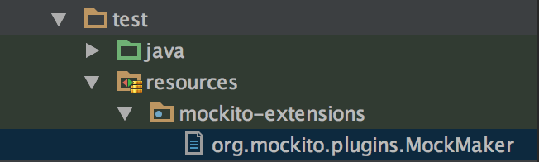
Mockito & Hamcrest Nuances (1)
mock-maker-inline

Slide 93
Mockito & Hamcrest Nuances (2)
org.mockito.exceptions.base.MockitoException:
Cannot mock/spy class za.co.ioagentsmith.game.kalaha.model.Player
Mockito cannot mock/spy because :
- final class
at za.co.ioagentsmith.game.kalaha.service.GameServiceTest.testSetup(GameServiceTest.kt:25)
at java.base/jdk.internal.reflect.NativeMethodAccessorImpl.invoke0(Native Method)

Slide 94
Mockito & Hamcrest Nuances (3)
`when`
`is`
Notes:
They are reserved keywords…

Slide 95
Enterprise journey recap
Spring 6 ready
Spring Boot 3 ready
Eager vs. Lazy
Enterprise
Kotlin
Junit 5 ready
Streams are Collections
Mockito ready
Notes:
Most of the stream operations we are used to from Java 8 are directly usable in Kotlin on the standard Collection classes, with no need to convert to a Stream first.
In addition, Kotlin adds more flexibility to how this works, by adding more operations that can be used and more variation on the existing operations.
However, Kotlin is eager by default, not lazy. This can cause additional work to be performed if we are not careful about the collection types that are being used.

Slide 96
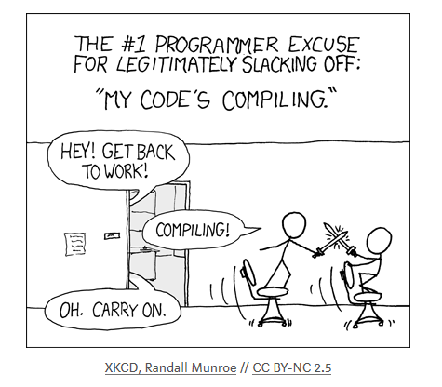
How performant is Kotlin?

Slide 97
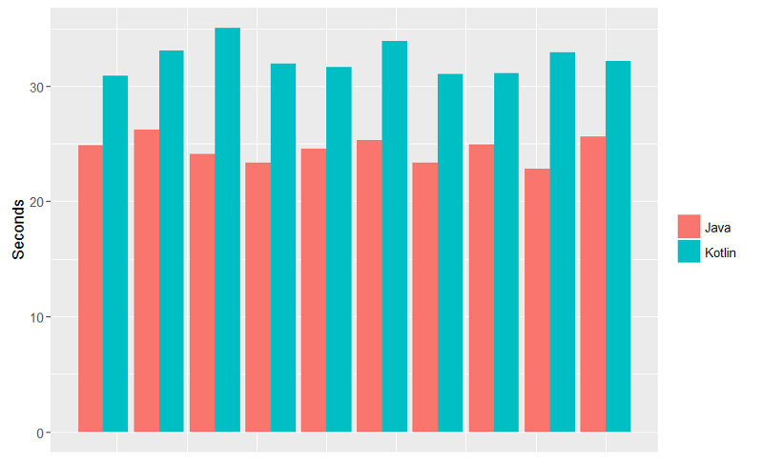
How performant is Kotlin? (1)
https://medium.com/keepsafe-engineering/kotlin-vs-java-compilation-speed-e6c174b39b5d

Slide 98
How performant is Kotlin? (2)
Compile time:
Java still winning the compile wars…
even with gradle daemons…
and incremental builds, but just…
Runtime:
Both compile to byte-code…
that run on JVM…
so run at relatively same speeds
References:
https://medium.com/keepsafe-engineering/kotlin-vs-java-compilation-speed-e6c174b39b5d
https://github.com/JetBrains/kotlin-benchmarks

Slide 99
In Summary
Targets Java 8
Compiles to
JVM bytecode
JavaScript
Easy to learn
Kotlin
Official support for Android
Costs nothing to adopt
Developed by JetBrains
Commercial support
From Industry
Notes:
Kotlin lets you choose the version of JVM for execution. By default, the Kotlin/JVM compiler produces Java 8 compatible bytecode. If you want to make use of optimizations available in newer versions of Java, you can explicitly specify the target Java version from 9 to 19. Note that in this case the resulting bytecode might not run on lower versions. Starting with Kotlin 1.5, the compiler does not support producing bytecode compatible with Java versions below 8.

Slide 100

Questions?
Slides and code available @
https://about.me/christoffsmith
Notes:
Classes, objects, interfaces, constructors, functions, properties and their setters can have visibility modifiers. (Getters always have the same visibility as the property.) There are four visibility modifiers in Kotlin:
private, protected, internal and public. The default visibility, used if there is no explicit modifier, is public.

